Slide 1
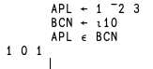
APL: A different Programming Language
18th of December 2021
M. Liarmakopoulos
APL ∊ BCN

Slide 2






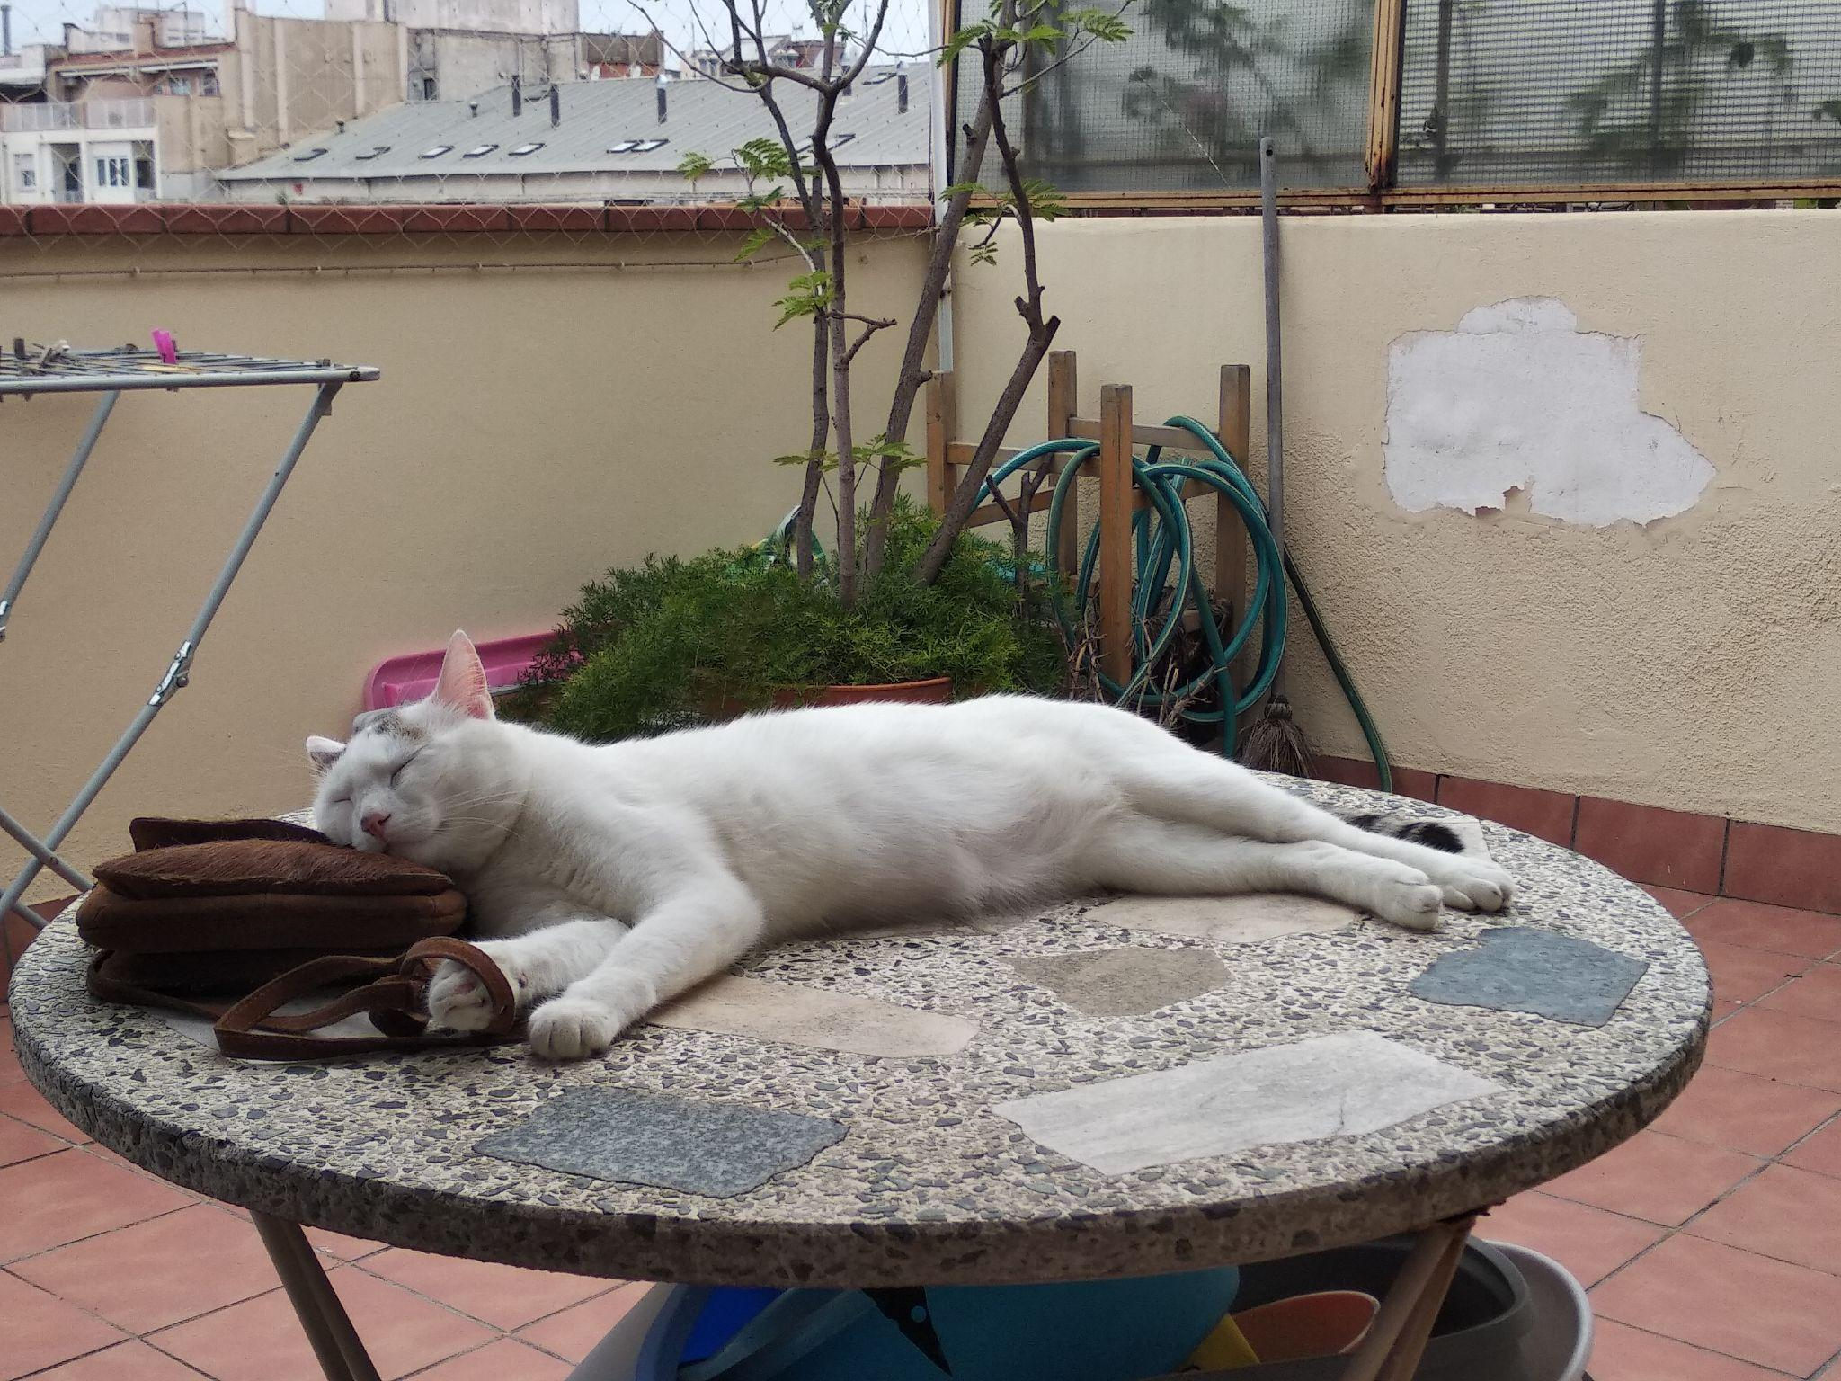
Who
Michail, Μιχάλης, Mike, Μάηκ
Greek living in Barcelona
Physics & Mathematics background
Data Engineer @ Webhelp ES
Cat father
Avid reader

Slide 3
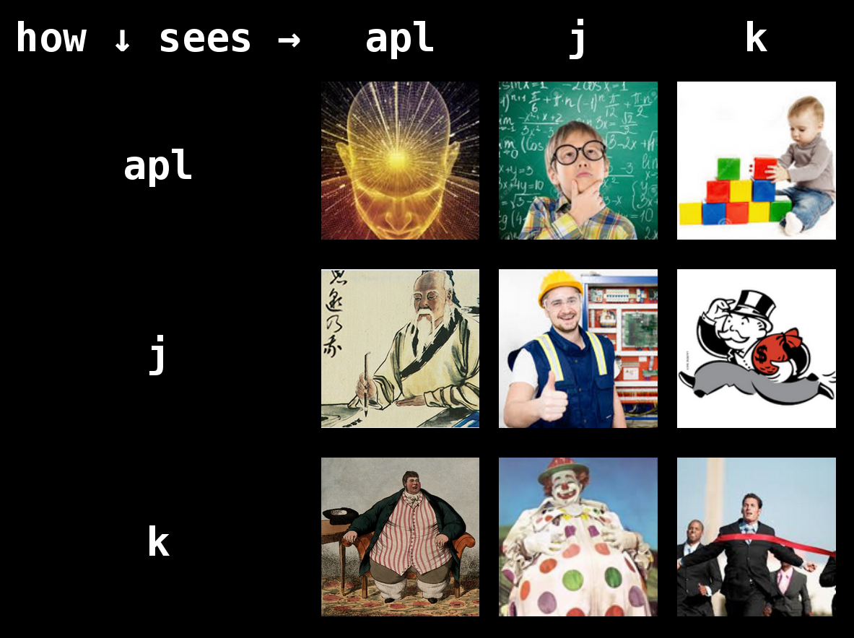
This talk
APL ∊ BCN
Goals
Meetups
Online/IRL
APL
Past
Present
Future
Live coding
Questions ???
References
Thanks

Slide 4
APL ∊ BCN: Goals
Spreading knowledge of APL and the array family of programming languages.
Spreading knowledge about Ken Iverson and other people involved in the development of APL.
Sharing knowledge related to the intersection of mathematics and programming.
Fostering a friendly community of people interested in array programming.

Slide 5
APL ∊ BCN: Meetups
General meetups (online & IRL)
Historical APL paper reading group (online)
General (paper, book) reading group (online)

Slide 6
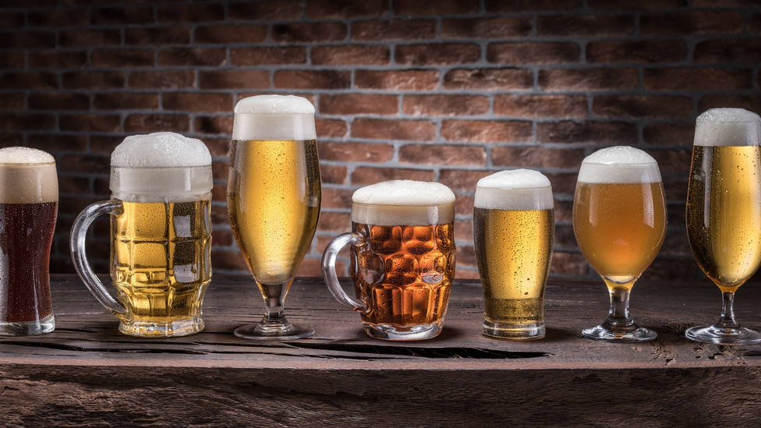
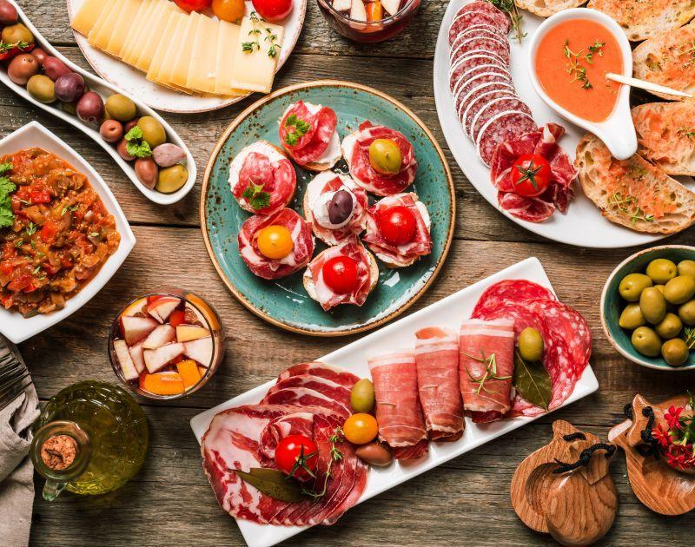
APL ∊ BCN: Online/IRL
Reasons for online meets:
Covid19
Accessibility of group’s activities from all over Spain/Europe/globe
Reasons for IRL meets:
Vision to establish a strong APLjk community in Spain based in Barcelona.
Cervezas, tapas/pinxos, chupitos !

Slide 7
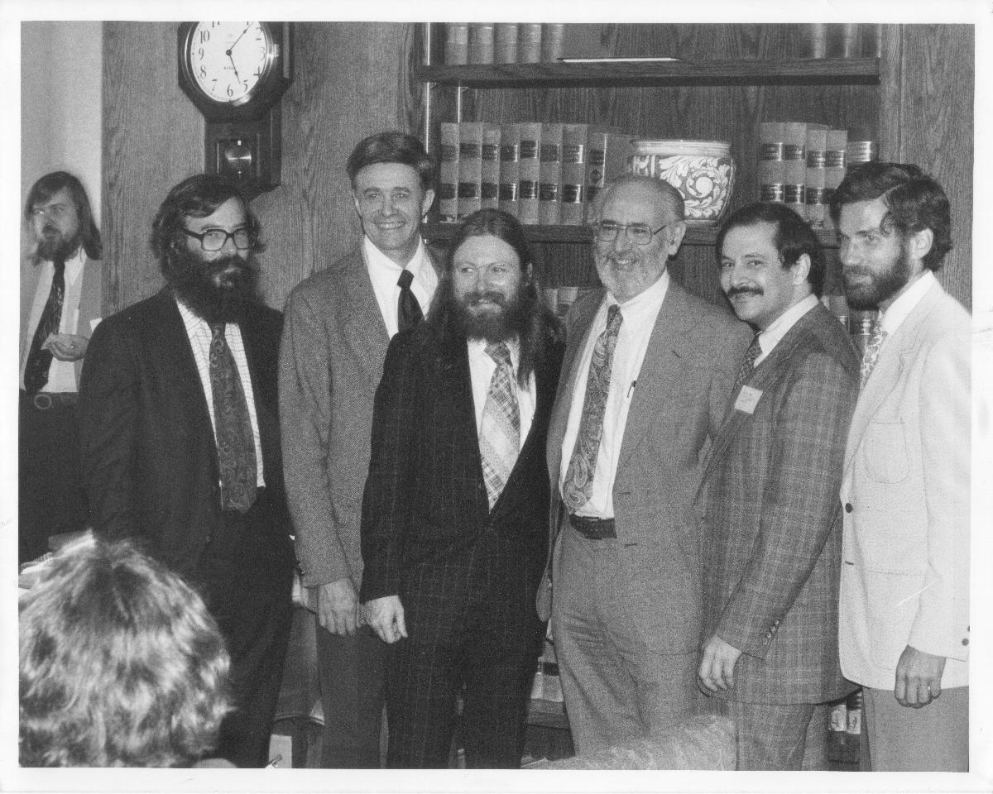
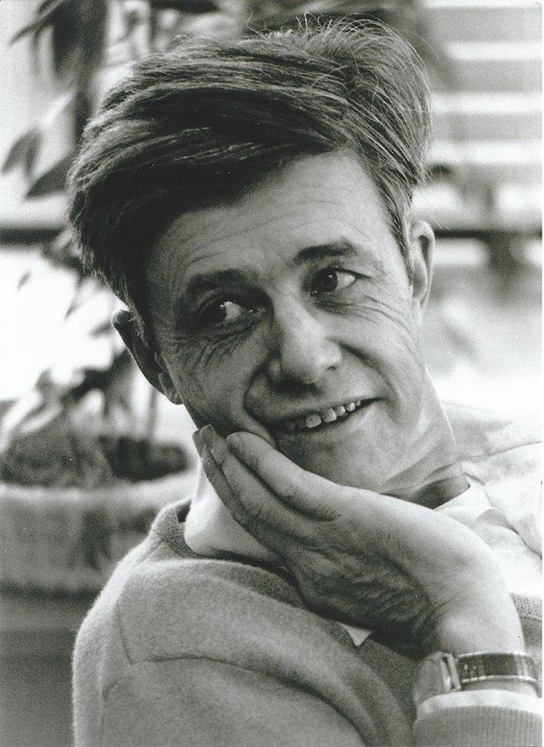
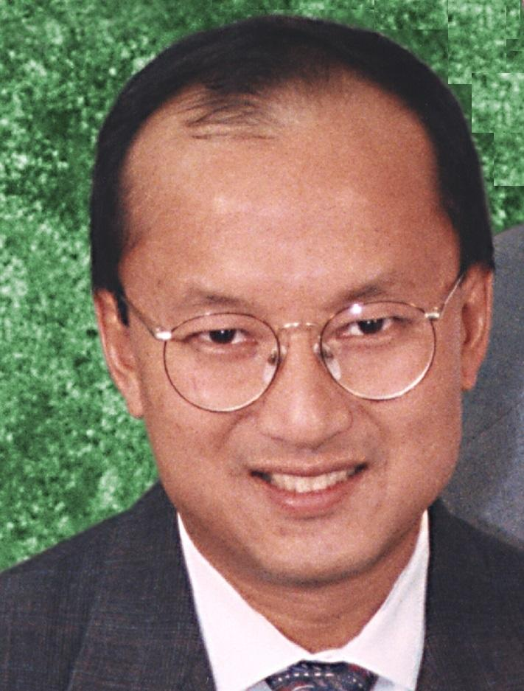
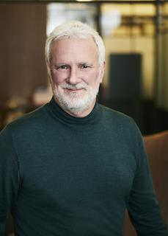
APL: Past
K. E. Iverson, A. Falkoff, “A Programming Language”, 1957-1962.
IBM System/360, 1964.
I. P. Sharp Associates (1964-2005), STSC (1969-2003).
APL2, 1980s.
Dyalog APL, 1981 - today.
A. Whitney, “A”, 1985; “A+”, 1988.
K. E. Iverson, R. Hui, “J”, 1990, E. K. Iverson.
A. Whitney, “K”, 1992 - today.

Slide 8

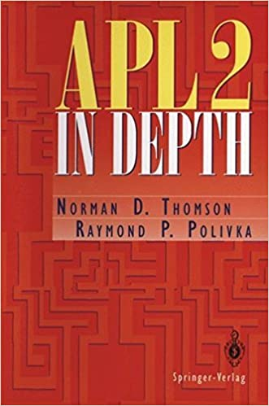

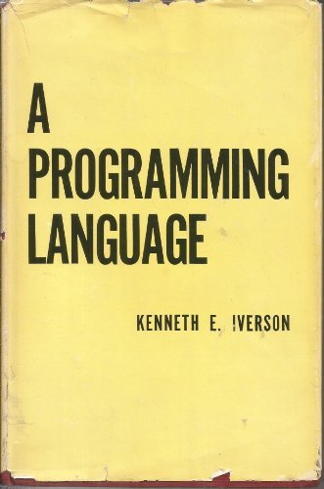
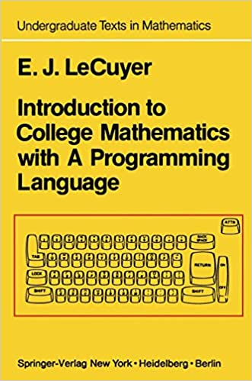

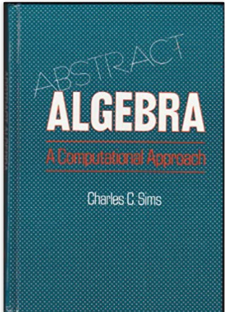
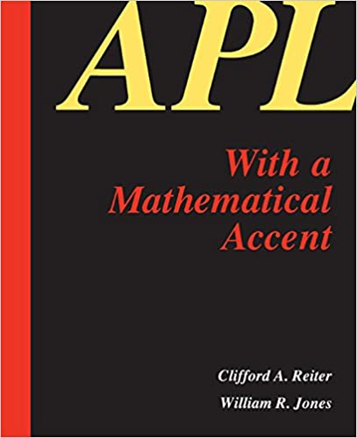
APL: Past

Slide 9


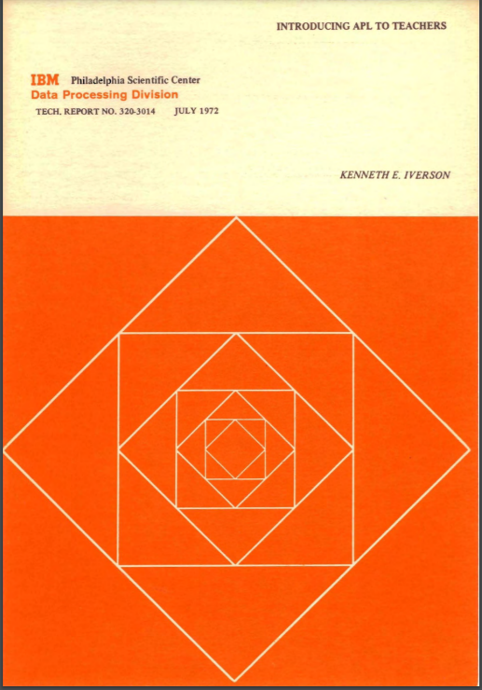

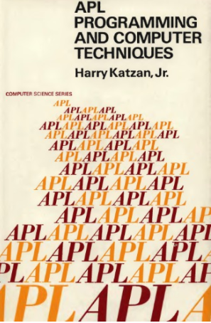
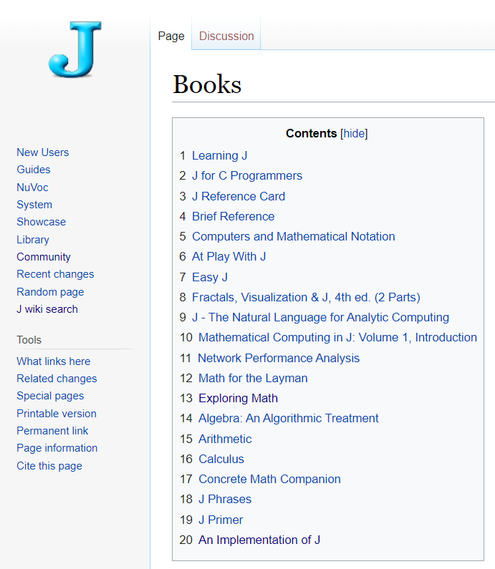
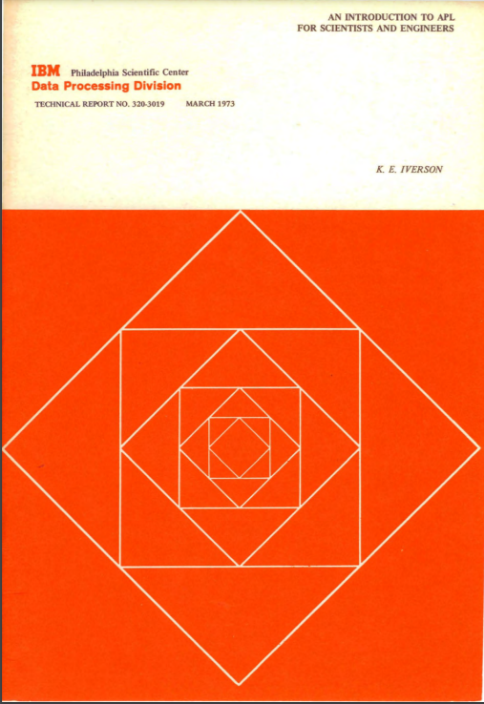
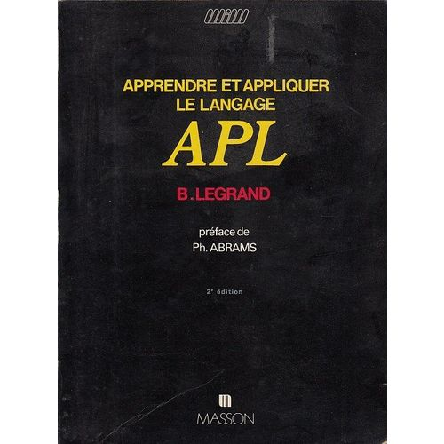


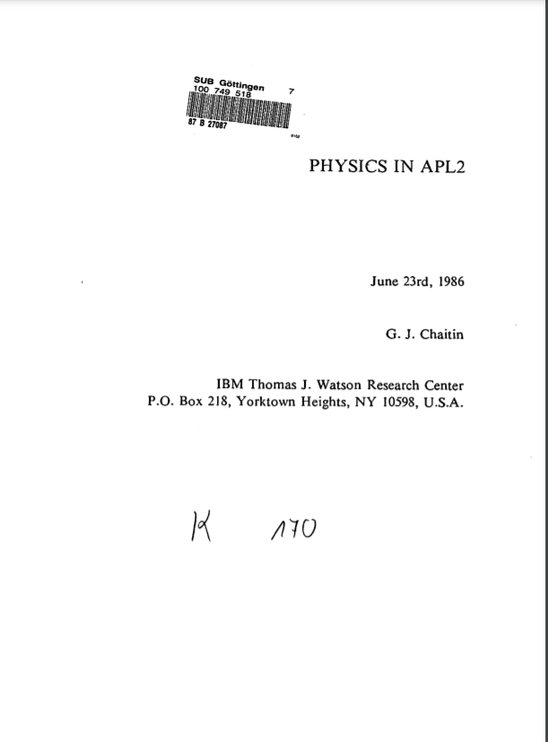
APL: Past

Slide 10

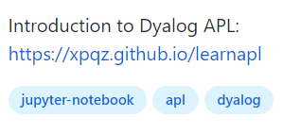
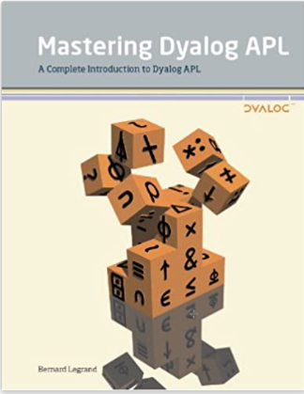
APL: Present
Dyalog APL v.18.0, v.18.2 (beta)
J, v.902, v.903 (beta)
K, v.9 "Shakti" / 2020
GNU APL v.1.8
BQN 2021
dzaima/APL v.0.1.7 / 2020-05-13
Nial v.7.0 / January 2017
KAP 2021
NARS2000 v.0.5 / 2019
NGN APL v.2018
Discord Community server
r/apljk
apl.chat
tryapl.org
Dyalog APL vocab.
arraycast

Slide 11
APL: Future
Co-dfns
Dyalog APL
Jsoft.
Co-dfns
Dyalog APL
J
K
BQN
Other array languages
APL competitions
APL conferences
APL user groups
Web development with APL
Py’n’APL
Computational science with APL
Teaching mathematics with APL/J
Machine learning with APL
???
Kx
BQN
Array langs
APL compet.
User groups
Conf.
Web apps
Cha07
Py'n'APL
APL, J
ANNs
???

Slide 12
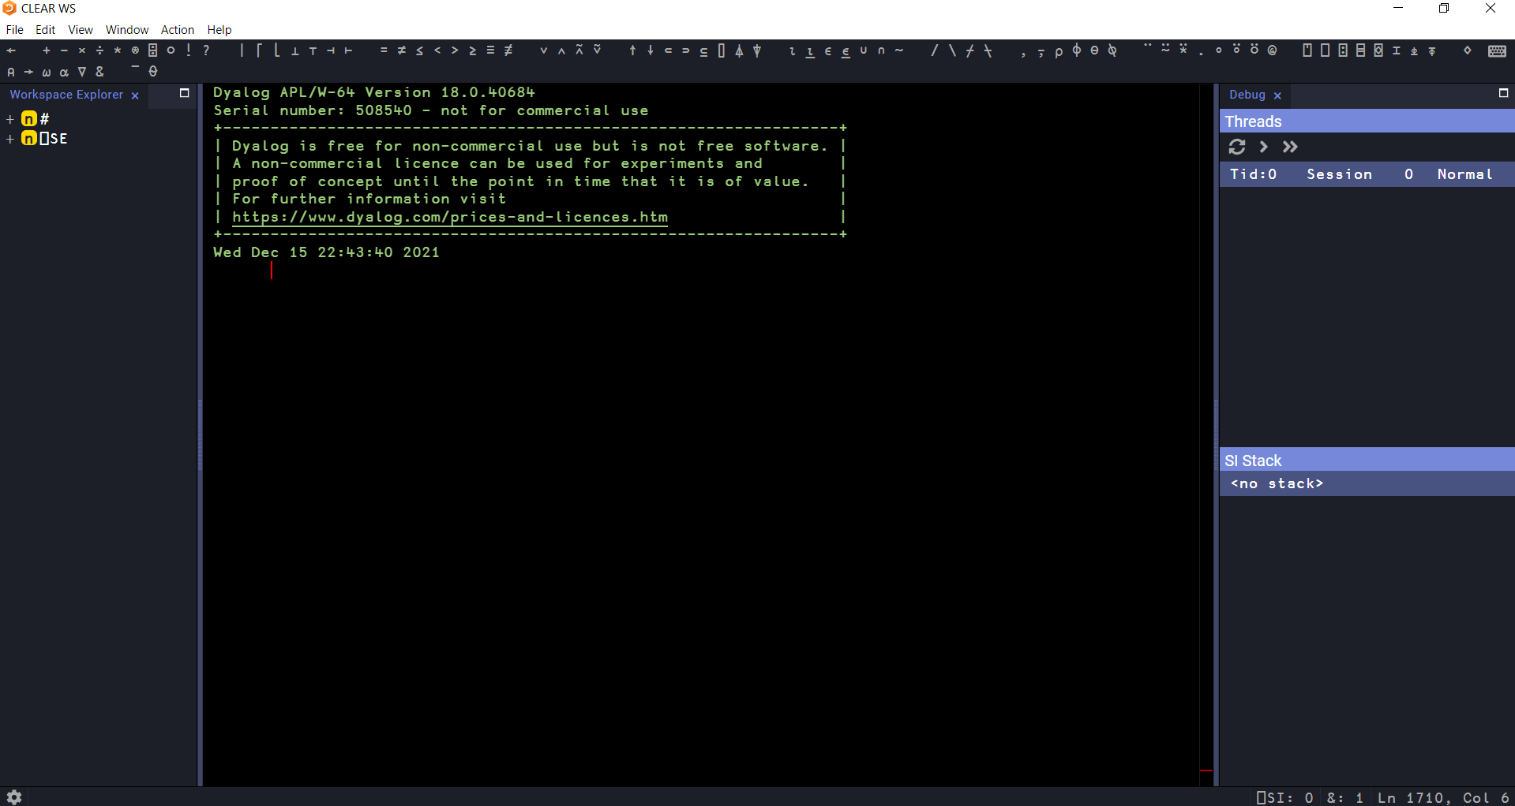
Live Coding

Slide 13
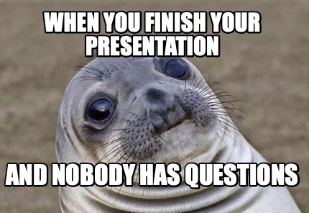
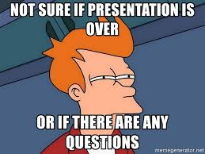

Questions ???

Slide 14
References(1/2)
https://mlliarm.github.io/apl-in-bcn/ (user group’s page, lots of useful material)
Portal: apl.wiki
Try APL on your browser: tryapl.org
https://en.wikipedia.org/wiki/APL_(programming_language)
https://aplwiki.com/wiki/Ken_Iverson
https://dblp.org/pid/75/296.html (Ken’s publications)
https://aplwiki.com/wiki/Roger_Hui
https://dblp.org/pid/54/3627.html (Roger’s publications)
https://code.jsoftware.com/wiki/Community/Creative_Commons (Various APL papers)
https://www.afapl.asso.fr/topo.pdf ("Le langage APL au service de la physique", C. Chachaty 2007)
https://tinyurl.com/chachaty-qm ("Une application d'apl en mecanique quantique : les niveaux d'energie d'un systeme de spins electroniques et nucleaires", C. Chachaty 1996)
https://tinyurl.com/chachaty-diffeq ("Quelques fonctions apl simples pour la resolution numerique des equations et systemes differentiels", C. Chachaty)
http://www.softwarepreservation.org/projects/apl/Books/Physics%20in%20APL2/view (Greg. Chaitin, Mathematical Physics with APL2)

Slide 15
References(2/2)
K. E. Iverson, The use of APL in teaching, 1968
K. E. Iverson, Introducing APL to teachers, 1972
K. E. Iverson, An introduction to APL for scientists and engineers, 1973
R. K.W. Hui, M. J. Kromberg, APL Since 1978, 2020
https://www.goodreads.com/book/show/6016310-a-programming-language
https://en.wikipedia.org/wiki/Kenneth_E._Iverson
https://en.wikipedia.org/wiki/Adin_Falkoff
https://en.wikipedia.org/wiki/IBM_System/360
https://en.wikipedia.org/wiki/File:APL_developers.jpg
https://en.wikipedia.org/wiki/APL_(programming_language)#History
https://aplwiki.com/wiki/J
https://www.jsoftware.com/papers/tot.htm
https://en.wikipedia.org/wiki/J_(programming_language)
https://en.wikipedia.org/wiki/I._P._Sharp_Associates
https://en.wikipedia.org/wiki/Scientific_Time_Sharing_Corporation
https://aplwiki.com/wiki/K
https://en.wikipedia.org/wiki/Arthur_Whitney_(computer_scientist)
https://en.wikipedia.org/wiki/Roger_Hui

Slide 16
Thanks
Adám Brudzewsky (Dyalog Ltd.)
Conor Hoekstra (@code_report)
Dyalog Ltd.
All the very friendly and welcoming APLjk community.

